Slide 1
Hackathon’25 : Solve Rubik’s Cube

Slide 2
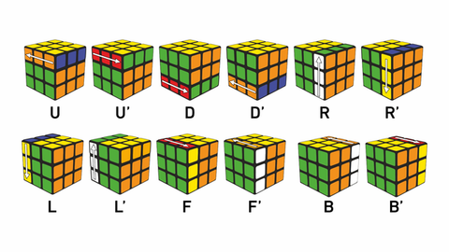
Solve Rubik’s Cube
Overview
Participants are challenged to design and implement an algorithm that can solve a standard 3x3 Rubik’s Cube from any scrambled state. The solution must mimic the real-world logic of solving a cube through a sequence of valid moves.
What We’re Looking For : 🔍
Problem-Solving Approach
How do you break down the problem?
How do you model the cube’s state and transitions?
Use of Data Structures
How do you represent the cube internally (e.g., arrays, trees, graphs)?
Use of efficient structures to track states and operations.
State Prediction Logic
Ability to track and predict cube state after each move.
Design of a move engine to simulate rotations and track permutations.
Algorithm Efficiency
How fast can your solution reach the solved state?
Complexity (time and space) of your algorithm.
Bonus Evaluation Areas
Creativity in solution design.
Visual simulation or cube UI (optional but Wow factor).
Scalability for different cube sizes (2x2, 4x4, etc.) : Optional
Deliverables:
Working algorithm (code)
Brief walkthrough/presentation of your approach
Output example(s) from your solver
It’s Not Just a Puzzle - It’s a Test of Mind, Math, and Moves!

Slide 3
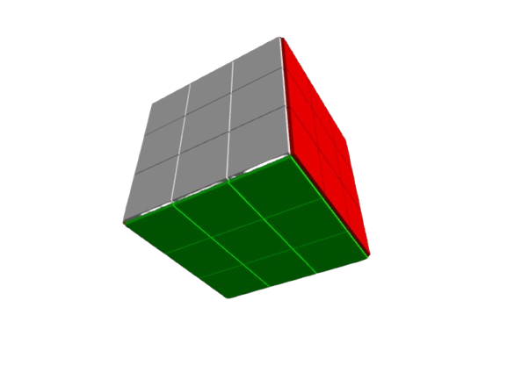
An interactive 3D solver for the Rubik's Cube challenge
Project for the Design Dexterity Challenge
KSHITIJ VERMA
A project delivering both an efficient solver and an interactive user interface.

Slide 4
An overview of the project and its goals
The primary challenge is to design and implement a robust algorithm that can solve a 3x3 Rubik's Cube from any scrambled state.
Our goal was to create not only a logical solver but also an engaging, interactive 3D interface to visualize the cube's state and solution path.
The core challenge is to design a robust solver with a visual interface.

Slide 5
Our solution and technical approach
We developed a fully functional Rubik's Cube simulator in Python, featuring a 3D visual interface powered by the VPython library.
The cube is modeled as a collection of 54 distinct tiles, each with a unique 3D position and color vector.
A move engine simulates rotations by applying matrix transformations to the relevant tiles for each face turn.
We developed a full 3D simulation in Python to model and solve the cube.

Slide 6
Data structures for state representation
To interface with the solving algorithm, the visual 3D state is translated into a 54-character "definition string.“
Each position on the cube corresponds to a specific index in the string, and its character represents the sticker's face color (e.g., 'F' for Front face color).
This string is the core data structure that efficiently represents the entire cube state for the algorithm.
The cube's state is translated into a 54-character string for the solver.

Slide 7
The algorithm used for solving the cube
We integrated the highly efficient Kociemba two-phase algorithm to find the solution path.
This algorithm is renowned for its ability to find near-optimal (short) solutions very quickly, making it ideal for this challenge.
It was implemented using the kociemba Python library, which takes the 54-character state string as input and returns a solution sequence.
We implemented the highly efficient Kociemba algorithm for optimal solutions.

Slide 8
An interactive visual simulation with VPython
The project features a full 3D user interface that allows for a rich, interactive user experience.
Key Features:-
Full camera control (rotate, pan, and zoom).
Interactive buttons for manual rotations, scrambling, and solving.
Real-time animation of the cube's movements.
The 3D interface provides a key "wow factor" and enhances user experience.
Real-time animation provides a clear and engaging demonstration of the solution.

Slide 9
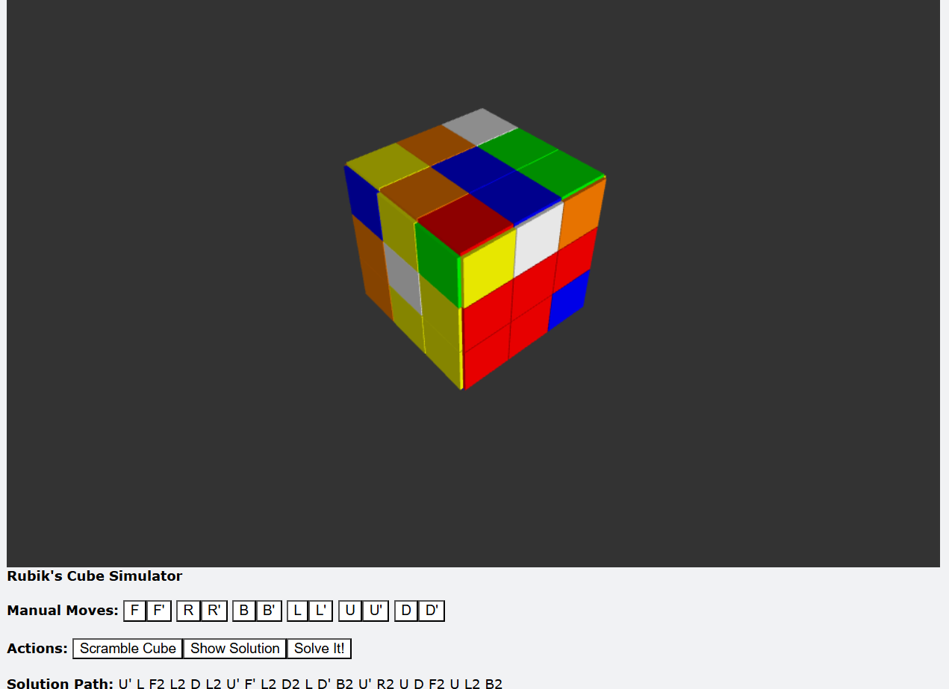
A live demonstration of the solver
A full demo video is included separately in the submission folder.

Slide 10
Conclusion and summary of achievements
Successfully designed and implemented a solution that solves a 3x3 Rubik's Cube from any state.
Delivered not only a working algorithm but also an enhanced user experience through an interactive 3D visual interface.
The final program meets all core requirements and bonus objectives of the Design Dexterity Challenge.
The project successfully meets all core and bonus challenge requirements.

Slide 11
THANKYOU

